Slide 1

Immersed Boundary Method applied to the LBM
Isabelle Cheylan, Julien Favier, Pierre Sagaut
M2P2, Aix-Marseille Univ/CNRS

Slide 2
Theory & equations
Academic test cases :
  2D Oscillating cylinder in a laminar flow
  3D translating sphere in a laminar flow
  2D Obstructed channel in a laminar flow
  3D Wall modeled LES oscillating cylinder in a turbulent flow
Industrial test case
  3D rotating GMV (Groupe Moto Ventilateur) in a turbulent flow
Conclusion and Work in progress

Slide 3
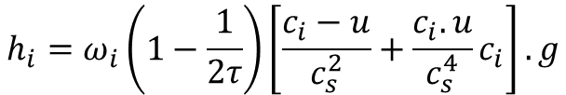
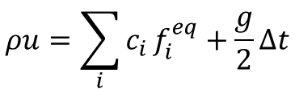
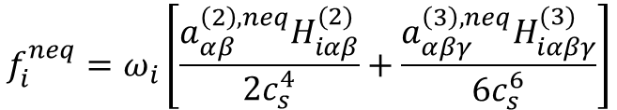
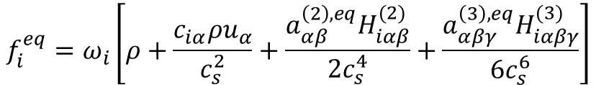
Theory and equations
Lattice-Boltzmann equation :
Expression of the external force g in the lattice space :
Expression of the equilibrium function (HRR collision model) :
Expression of the non equilibrium function (HRR collision model) :
Expression of the momentum with an external force g :
$$f_{i}\left(x+c_{i}∆t, t+∆t\right)=f_{i}^{eq}\left(x,t\right)+\left(1−\frac{1}{τ}\right)f_{i}^{neq}\left(x,t\right)+\frac{1}{2}h_{i}\left(x,t\right)$$
$$h_{i}=ω_{i}\left(1−\frac{1}{2τ}\right)\left[\frac{c_{i}−u}{c_{s}^{2}}+\frac{c_{i}.u}{c_{s}^{4}}c_{i}\right].g$$
$$f_{i}^{eq}=ω_{i}\left[ρ+\frac{c_{iα}ρu_{α}}{c_{s}^{2}}+\frac{a_{αβ}^{\left(2\right),eq}H_{iαβ}^{(2)}}{2c_{s}^{4}}+\frac{a_{αβγ}^{\left(3\right),eq}H_{iαβγ}^{(3)}}{6c_{s}^{6}}\right]$$
$$f_{i}^{neq}=ω_{i}\left[\frac{a_{αβ}^{\left(2\right),neq}H_{iαβ}^{(2)}}{2c_{s}^{4}}+\frac{a_{αβγ}^{\left(3\right),neq}H_{iαβγ}^{(3)}}{6c_{s}^{6}}\right]$$
$$ρu=\sum_{i}{c_{i}}f_{i}^{eq}+\frac{g}{2}∆t$$

Slide 4

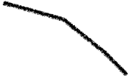

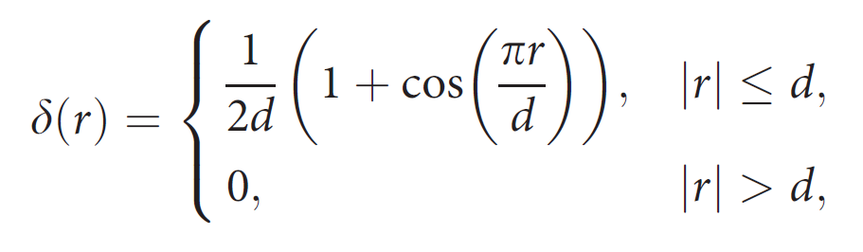
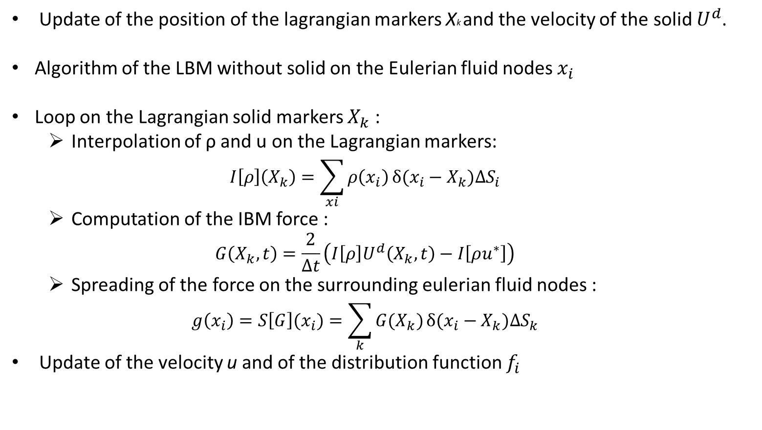


Theory and equations
Gsell et al, 2019,2021 Favier, 2016
Update of the position of the lagrangian markers Xk and the velocity of the solid $U^{d}$.
Algorithm of the LBM without solid on the Eulerian fluid nodes $x_{i}$
Loop on the Lagrangian solid markers $X_{k}$ :
  Interpolation of ρ and u on the Lagrangian markers:
  $$I\left[ρ\right]\left(X_{k}\right)=\sum_{xi}{ρ\left(x_{i}\right)}δ(x_{i}−X_{k})∆S_{i}$$
  Computation of the IBM force :
  $$G\left(X_{k},t\right)=\frac{2}{∆t}\left(I\left[ρ\right]U^{d}\left(X_{k},t\right)−I\left[ρu^{∗}\right]\right)$$
  Spreading of the force on the surrounding eulerian fluid nodes :
  $$g\left(x_{i}\right)=S\left[G\right](x_{i})=\sum_{k}{G(X_{k})}δ(x_{i}−X_{k})∆S_{k}$$
Update of the velocity u and of the distribution function $f_{i}$
: Eulerian nodes $X_{k}$
: Lagrangian nodes $x_{i}$

Slide 5
Theory & equations
Academic test cases :
  2D Oscillating cylinder in a laminar flow
  3D translating sphere in a laminar flow
  2D Obstructed channel in a laminar flow
  3D Wall modeled LES oscillating cylinder in a turbulent flow
Industrial test case
  3D rotating GMV (Groupe Moto Ventilateur) in a turbulent flow
Conclusion and Work in progress

Slide 6
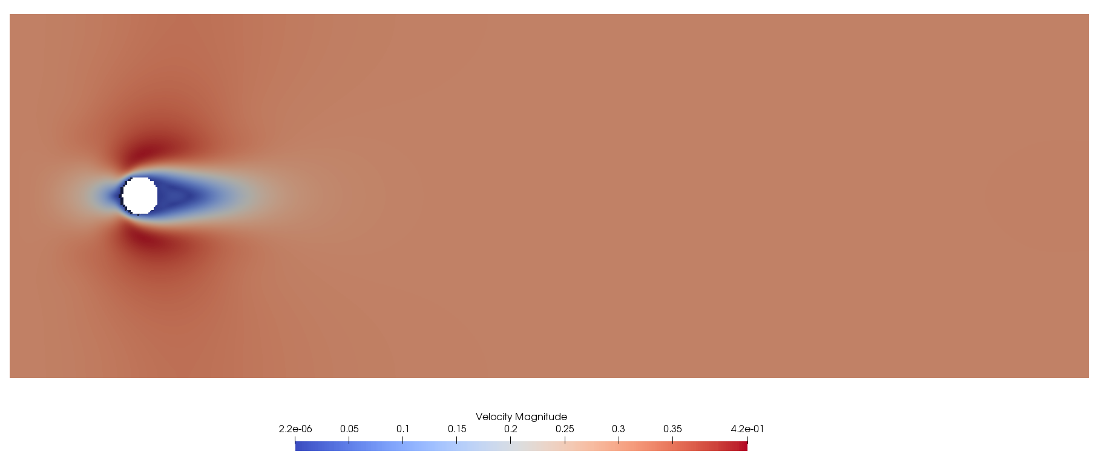
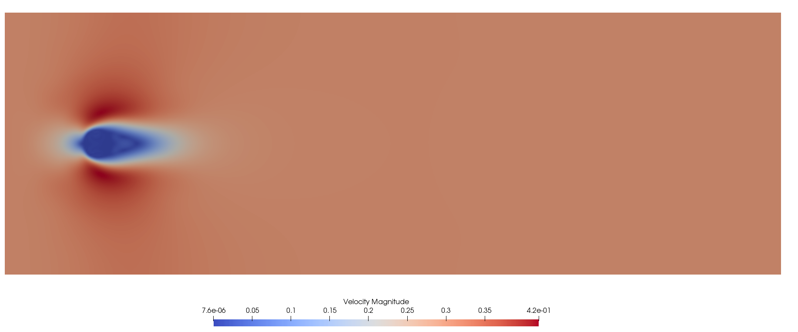
2D laminar fixed case : cylinder at Re = 30
Classical method in ProLB
Immersed Boundary Method in ProLB

Slide 7
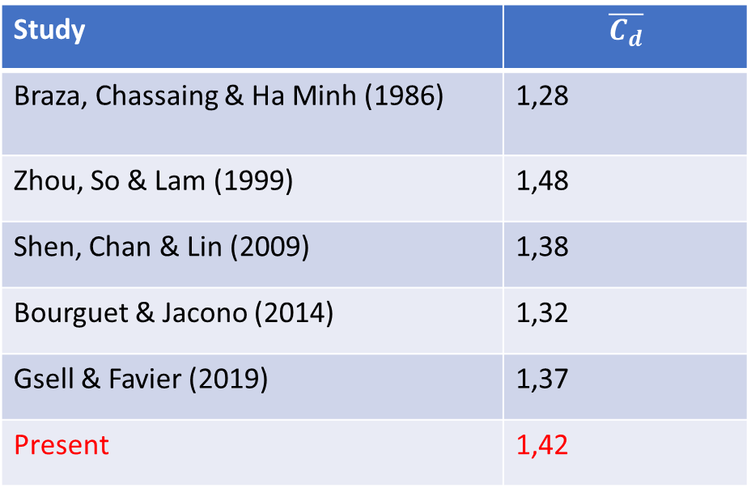
Mean drag coefficient on a cylinder for Re = 100
Study | $$\overline{C_{d}}$$
Braza, Chassaing & Ha Minh (1986) | 1,28
Zhou, So & Lam (1999) | 1,48
Shen, Chan & Lin (2009) | 1,38
Bourguet & Jacono (2014) | 1,32
Gsell & Favier (2019) | 1,37
Present | 1,42

Slide 8
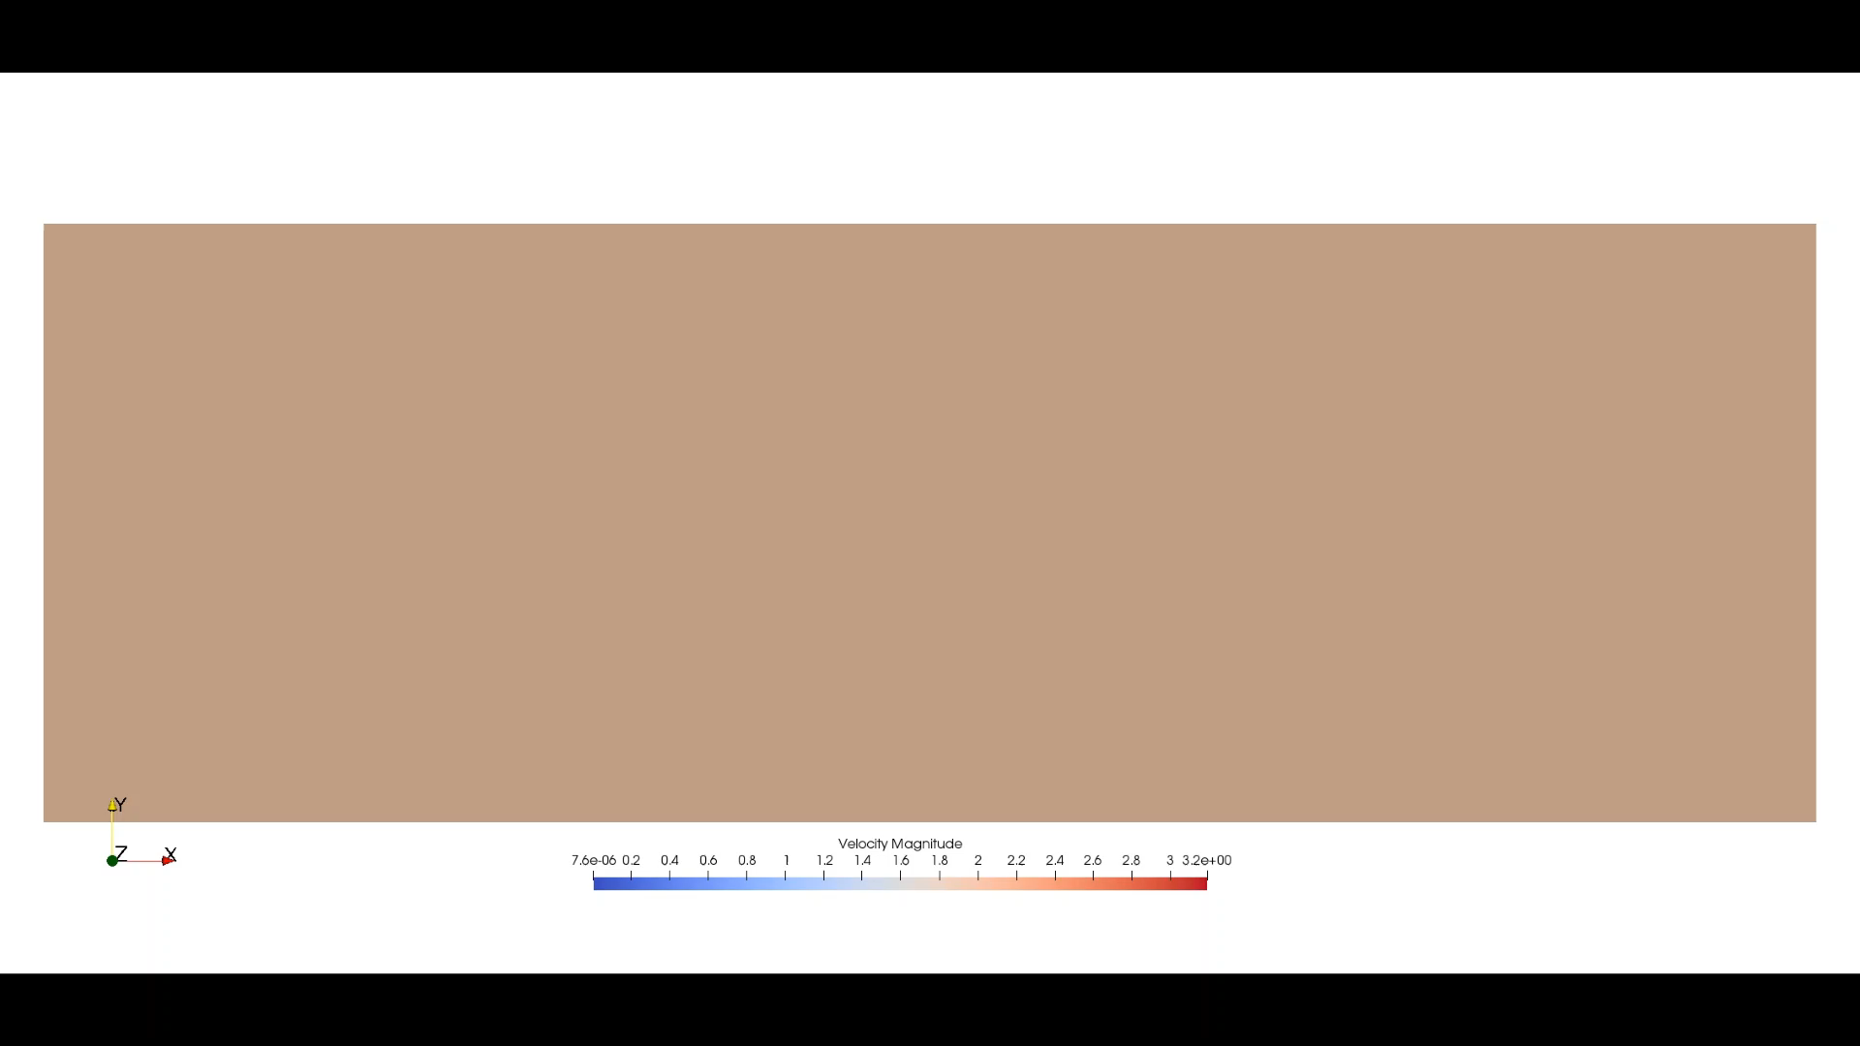
2D laminar moving case : oscillating cylinder at Re = 185

Slide 9
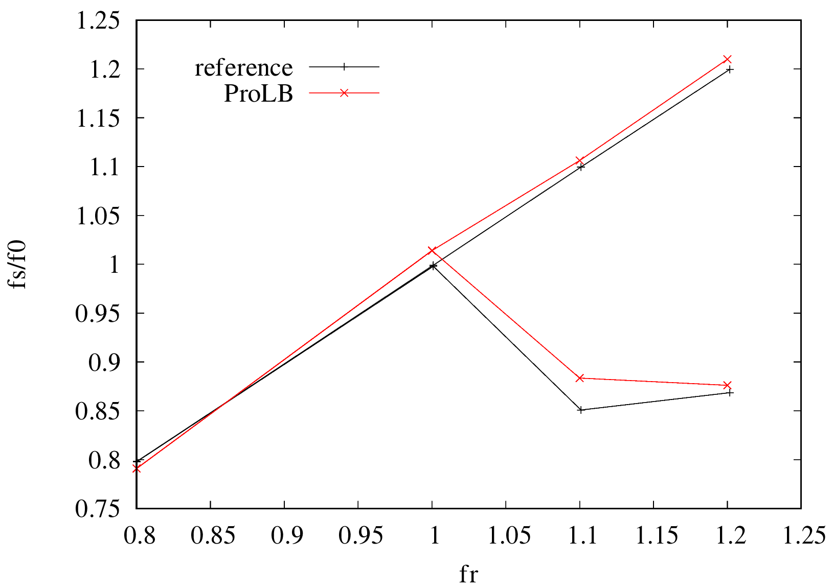
Ae = oscillating amplitude
fe = exciting frequency
f0 = natural shedding frequency for Re=185
fr = fe/f0
fs,P
fs,S
error max = 3.5%
Normalized vortex shedding frequency by the natural shedding frequency f0 as a function of the fr, where fs,P and fs,S are the primary and secondary frequencies of fs, respectively

Slide 10
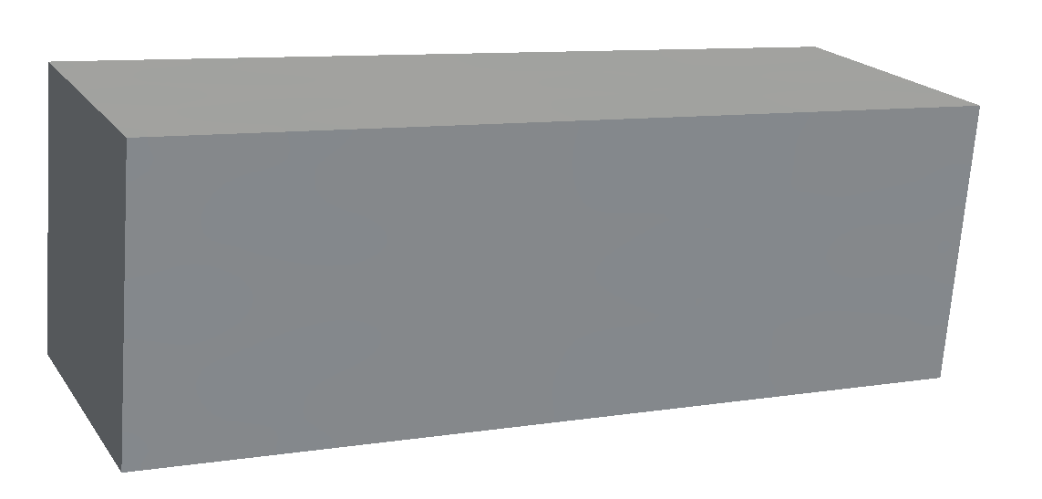
3D laminar moving sphere at Re = 185
Demonstration test case to show the industrial possibilities
Translation imposed to the sphere
The solver runs in parallel (22 processors) in 3D
3 meshing zones
2 155 949 nodes

Slide 11
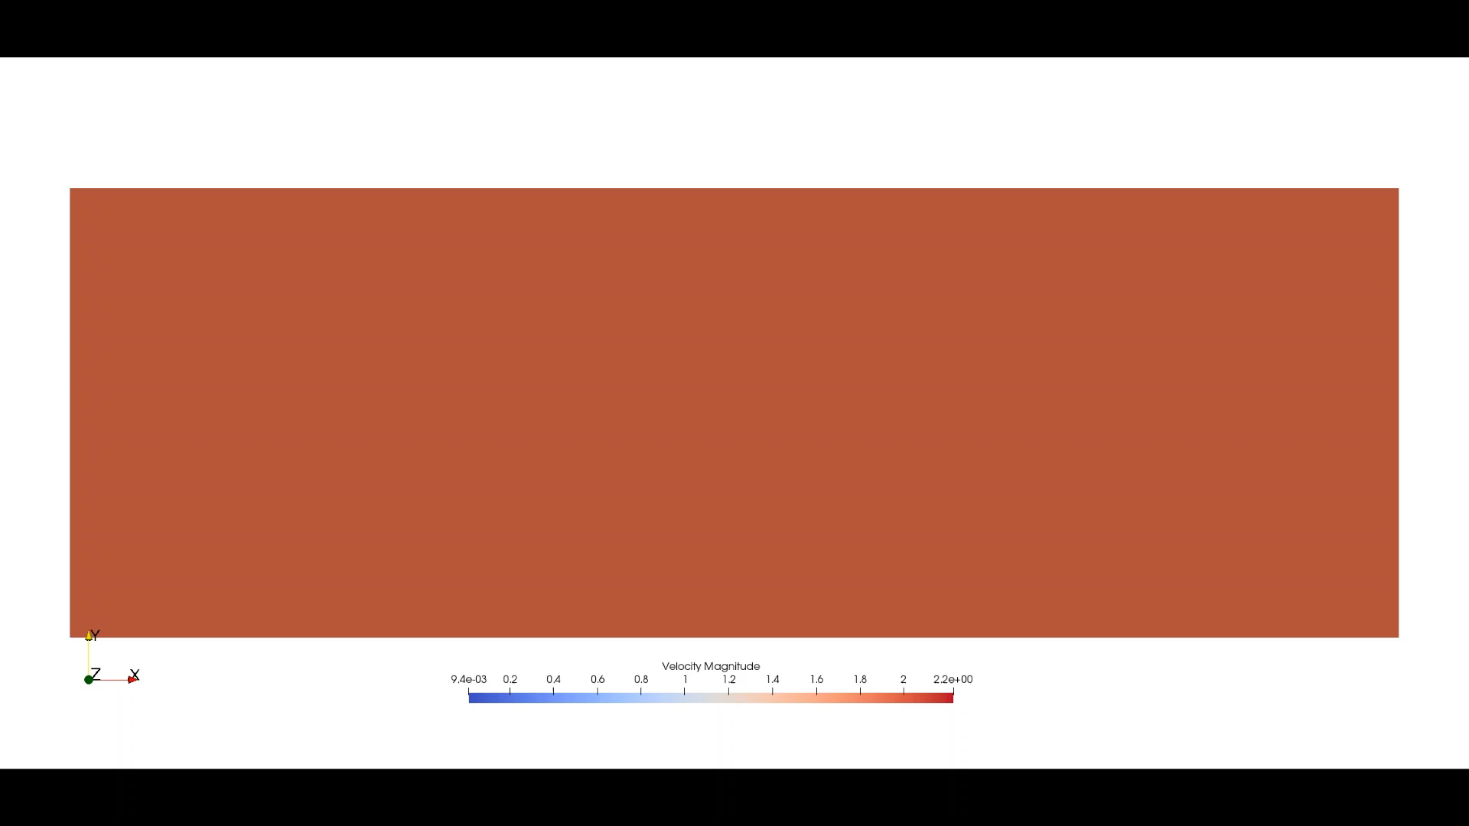
3D laminar moving case: sphere at Re = 185

Slide 12
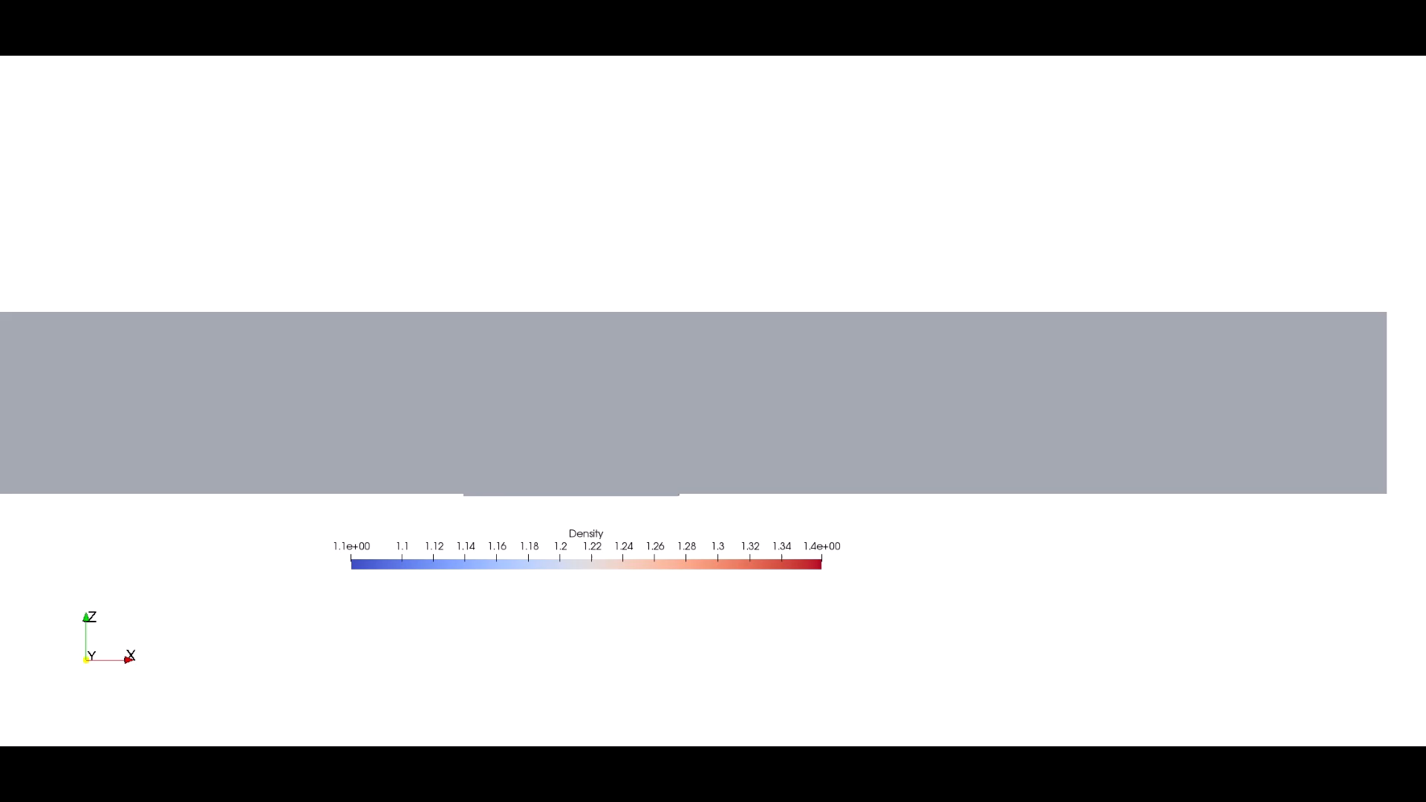
Obstructed channel
Inlet Reynolds number ≈ 4200
A valve closes the channel and then opens it again
What are the highlights :
  Can the IBM support contact between 2 solids for some time ?
  Is there some leakage across the valve ?

Slide 13
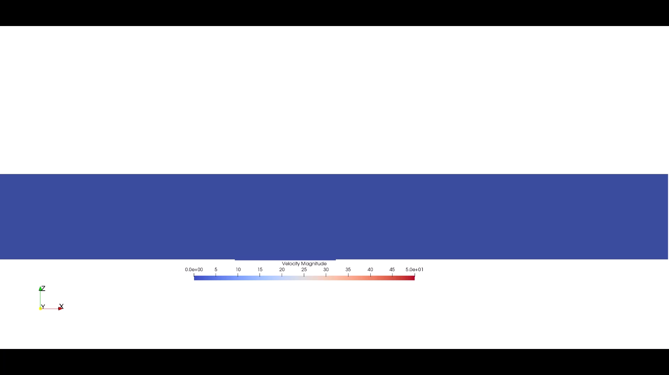

Slide 14
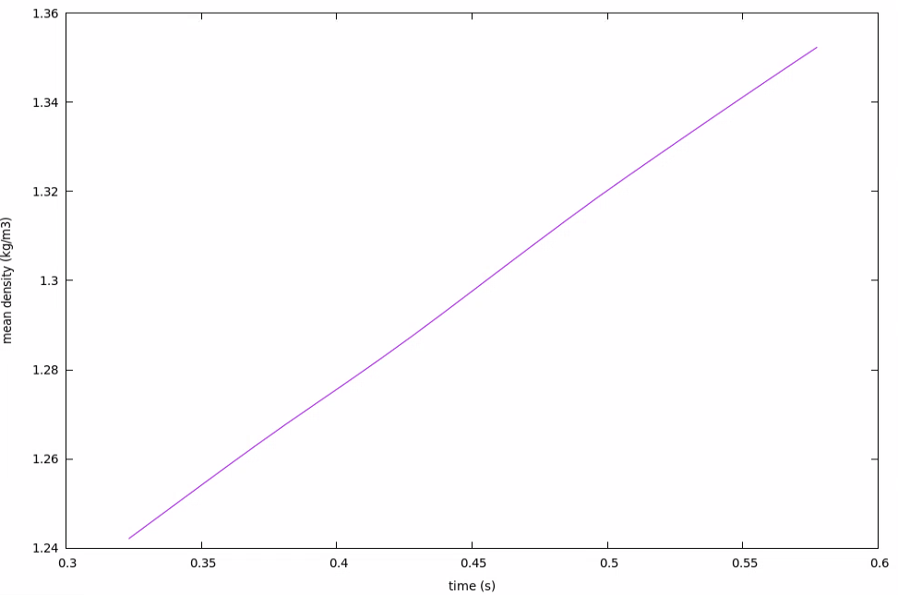





Theory
Simulation
Mass at the left of the valve
Entrance flow rate
$m\left(t\right)=m\left(t_{0}\right)+Q t$
$t_{0}$= when the valve closes the channel
$m\left(t\right)=\int_{V}{ρ dV}$
$Q=ρ \left\|\vec{v_{0}}\right\| S$
$Q$ = V * slope
≈ 1 % error on Q due to leakage across the valve

Slide 15
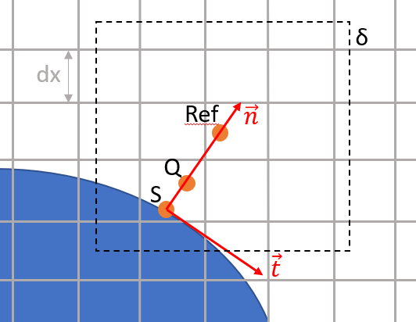


Turbulent case: coupling of a turbulent wall law to the immersed boundary
Shi et al, 2019
Set of Lagrangian points near the wall are introduced to compute the normal component of the IB force by reconstructing the normal component of the velocity
The momentum equation is integrated along the wall-normal direction to link the tangential component of the IB force to the wall shear stress predicted by the wall model
Obtained with the wall law
$$F_{t}(Q)≈2\frac{τ_{w}}{dx}$$
$$F_{n}\left(Q\right)=\frac{0−I_{Q}[u_{n}]}{dt}$$

Slide 16
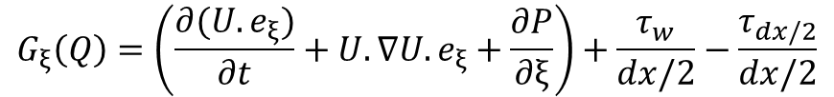
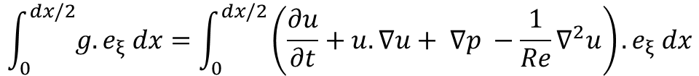
Algorithm of the turbulent immersed boundary
By integrating the momentum equation along the normal direction to link the effective body force to the wall shear stress:
$$\int_{0}^{dx/2}{g.e_{ξ} dx}=\int_{0}^{dx/2}{\left(\frac{∂u}{∂t}+u.∇u+ ∇p −\frac{1}{Re}∇^{2}u\right)}.e_{ξ} dx$$
By integrating the viscous terms between the wall and Ref point:
$$G_{ξ}\left(Q\right)=\left(\frac{∂(U.e_{ξ})}{∂t}+U.∇U.e_{ξ}+\frac{∂P}{∂ξ}\right)+\frac{τ_{w}}{dx/2}−\frac{τ_{dx/2}}{dx/2}$$

Slide 17


Algorithm of the turbulent immersed boundary
By integrating the momentum equation along the normal direction to link the effective body force to the wall shear stress:
$$\int_{0}^{dx/2}{g.e_{ξ} dx}=\int_{0}^{dx/2}{\left(\frac{∂u}{∂t}+u.∇u+ ∇p −\frac{1}{Re}∇^{2}u\right)}.e_{ξ} dx$$
By integrating the viscous terms between the wall and Ref point:
$$G_{ξ}\left(Q\right)=\left(\frac{∂(U.e_{ξ})}{∂t}+U.∇U.e_{ξ}+\frac{∂P}{∂ξ}\right)+\frac{τ_{w}}{dx/2}−\frac{τ_{dx/2}}{dx/2}$$
For the wall-modeled LES of a turbulent flow, the right-hand side can be approximated by the dominant wall shear stress term as follows:
$$G_{ξ}\left(Q\right)=2\frac{τ_{w}}{dx}$$
$$G_{n}(Q)=\frac{2}{∆t}\left(I\left[ρ\right]U_{n}^{d}−I\left[ρu_{n}^{∗}\right]\right)$$

Slide 18

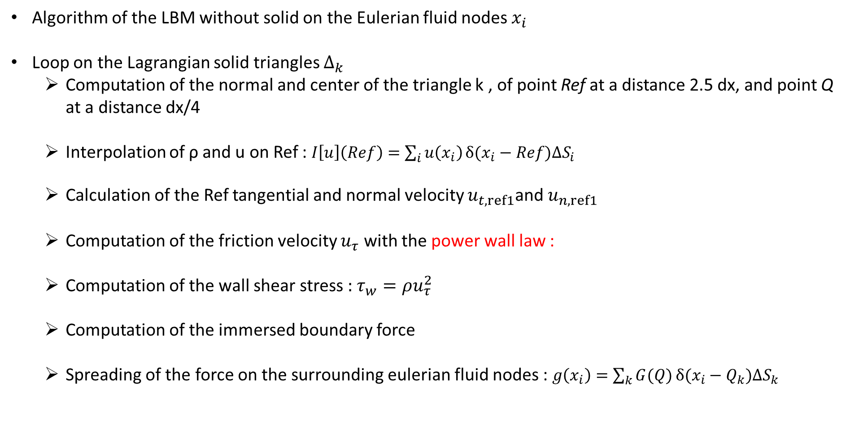
Algorithm of the turbulent immersed boundary
Algorithm of the LBM without solid on the Eulerian fluid nodes $x_{i}$
Loop on the Lagrangian solid triangles $∆_{k}$
  Computation of the normal and center of the triangle k , of point Ref at a distance 2.5 dx, and point Q at a distance dx/4
  Interpolation of ρ and u on Ref : $I\left[u\right]\left(Ref\right)=\sum_{i}{u\left(x_{i}\right)}δ(x_{i}−Ref)∆S_{i}$
  Calculation of the Ref tangential and normal velocity $u_{t,ref1}$and $u_{n,ref1}$
  Computation of the friction velocity $u_{τ}$ with the power wall law :
  Computation of the wall shear stress : $τ_{w}=ρu_{τ}^{2}$
  Computation of the immersed boundary force
  Spreading of the force on the surrounding eulerian fluid nodes : $g\left(x_{i}\right)=\sum_{k}{G(Q)}δ(x_{i}−Q_{k})∆S_{k}$

Slide 19
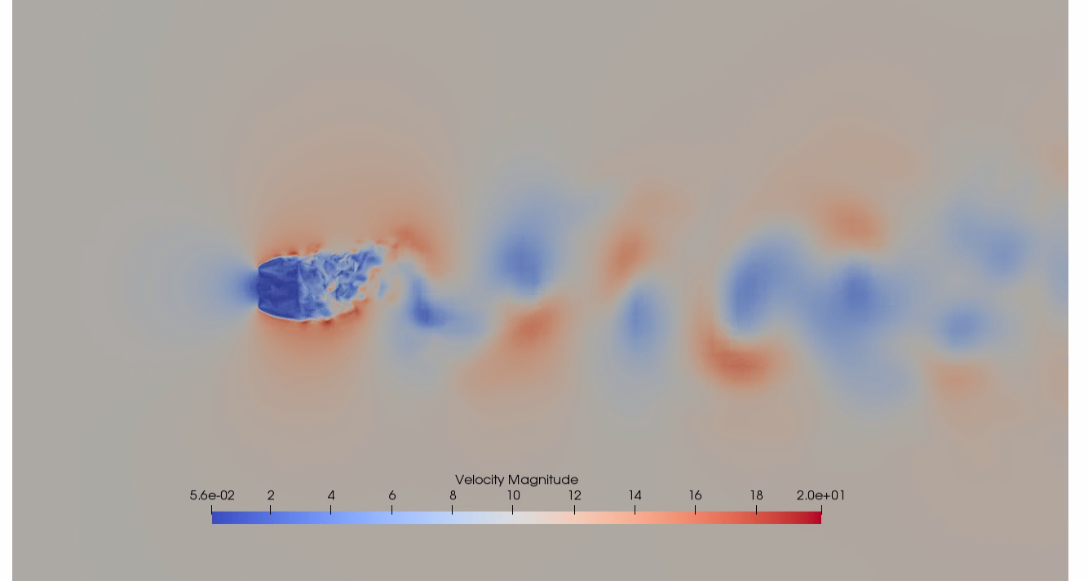
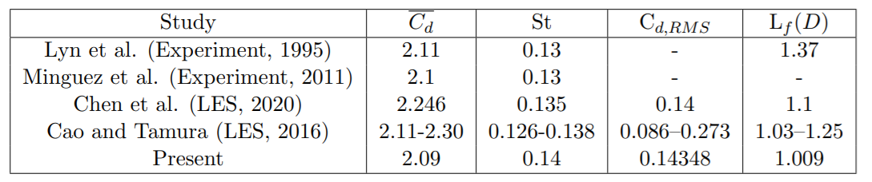
Large eddy simulation of a square cylinder at Re = 22000, Chen 2020
Fixed Square cylinder
Reynolds number = 22000
Smagorinsky model with a power wall law
50 nodes on the diameter

Slide 20
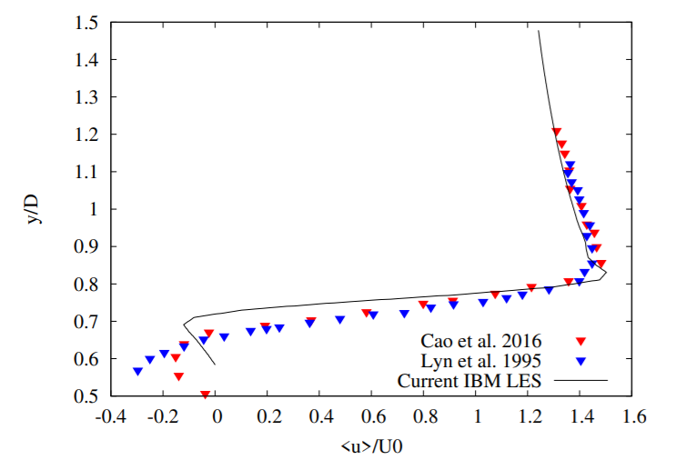
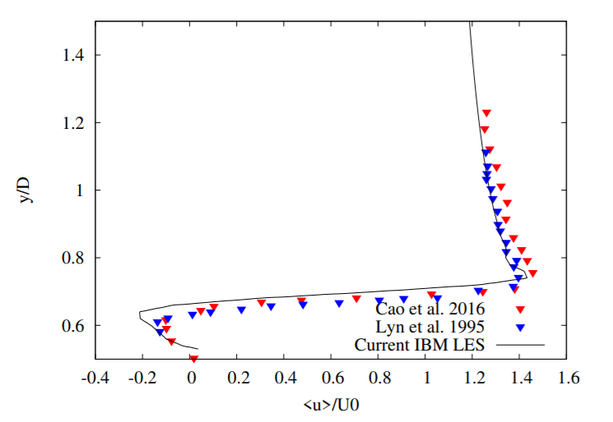
Large eddy simulation of a square cylinder at Re = 22000, Chen 2020
Velocity profile at the top of the cylinder in the shear layer at x/D = -0.25 (left) and x/D = 0 (right)
Comparison with experimental measurements (Lyn et al., 1995) and LES (Cao et al., 2016)

Slide 21
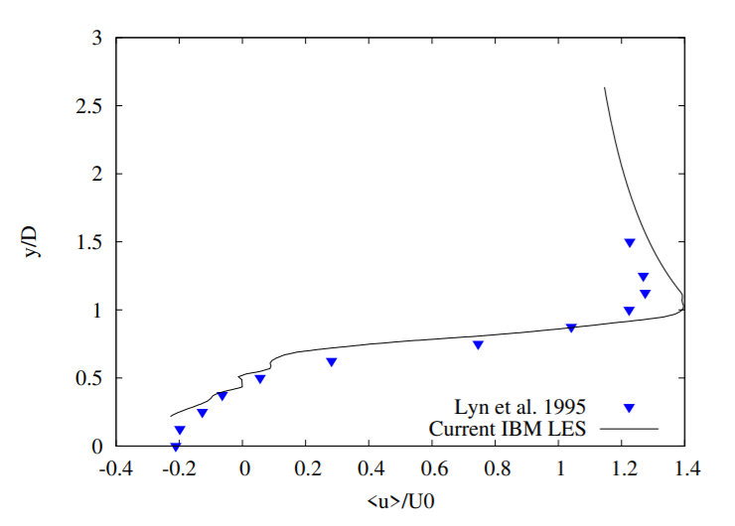
Large eddy simulation of a square cylinder at Re = 22000, Chen 2020
Separated shear layer dynamics is very well captured on the top and bottom sides of the cylinder
Shear layer evolution downstream the trailing edge corners is also well predicted
Velocity profile at the right of the cylinder in the near wake at x/D = 0.875
Comparison with experimental measurements (Lyn et al., 1995)

Slide 22
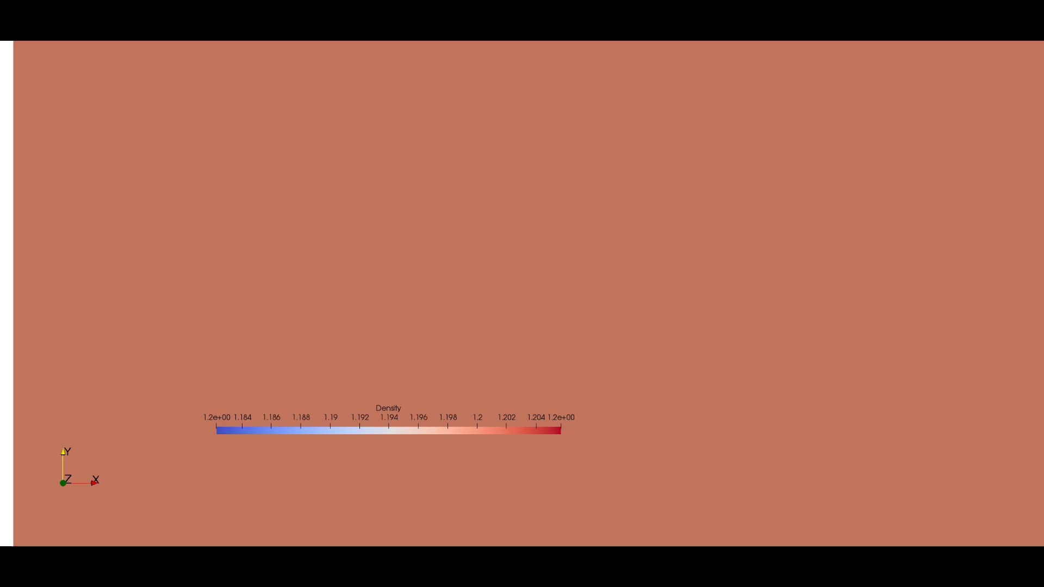
Large eddy simulation of an oscillating square cylinder at Re = 22000, Chen 2020
Square cylinder oscillating at a low amplitude
Reynolds number = 22000
Smagorinsky model with a power wall law
50 nodes on the diameter

Slide 23
Theory & equations
Academic test cases :
  2D Oscillating cylinder in a laminar flow
  3D translating sphere in a laminar flow
  2D Obstructed channel in a laminar flow
  3D Wall modeled LES oscillating cylinder in a turbulent flow
Industrial test case
  3D rotating GMV (Groupe Moto Ventilateur) in a turbulent flow
Conclusion and Work in progress

Slide 24
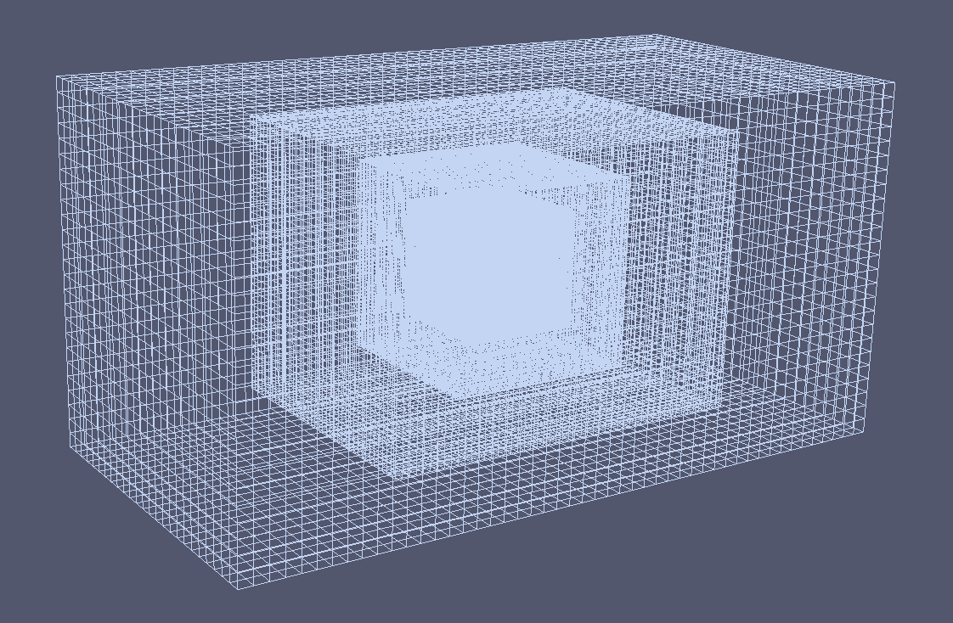
Data setup
Inlet velocity = 45,6 m/s
angular velocity = 0.22 rad/s
LES turbulence model (SISM)
1.5 million nodes
640 processors

Slide 25
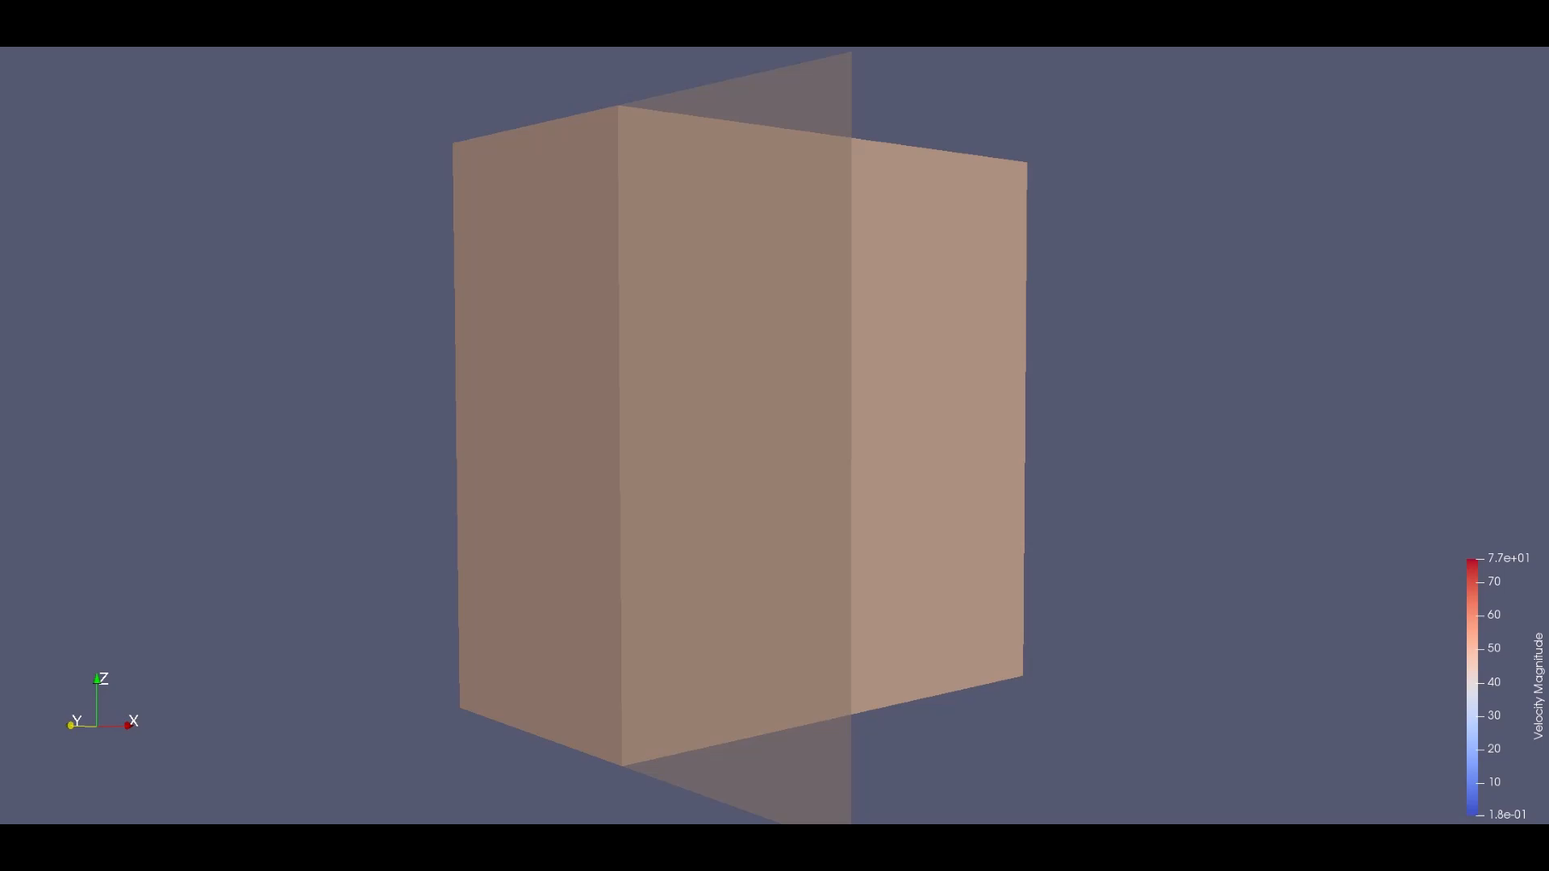

Slide 26
Theory & equations
Academic test cases :
  2D Oscillating cylinder in a laminar flow
  3D translating sphere in a laminar flow
  2D Obstructed channel in a laminar flow
  3D Wall modeled LES oscillating cylinder in a turbulent flow
Industrial test case
  3D rotating GMV (Groupe Moto Ventilateur) in a turbulent flow
Conclusion and Work in progress

Slide 27
Work in progress
Fluid structure interaction
Contact between 2 solids
Reciprocity of the interpolating and spreading operators in the immersed boundary method

Slide 28
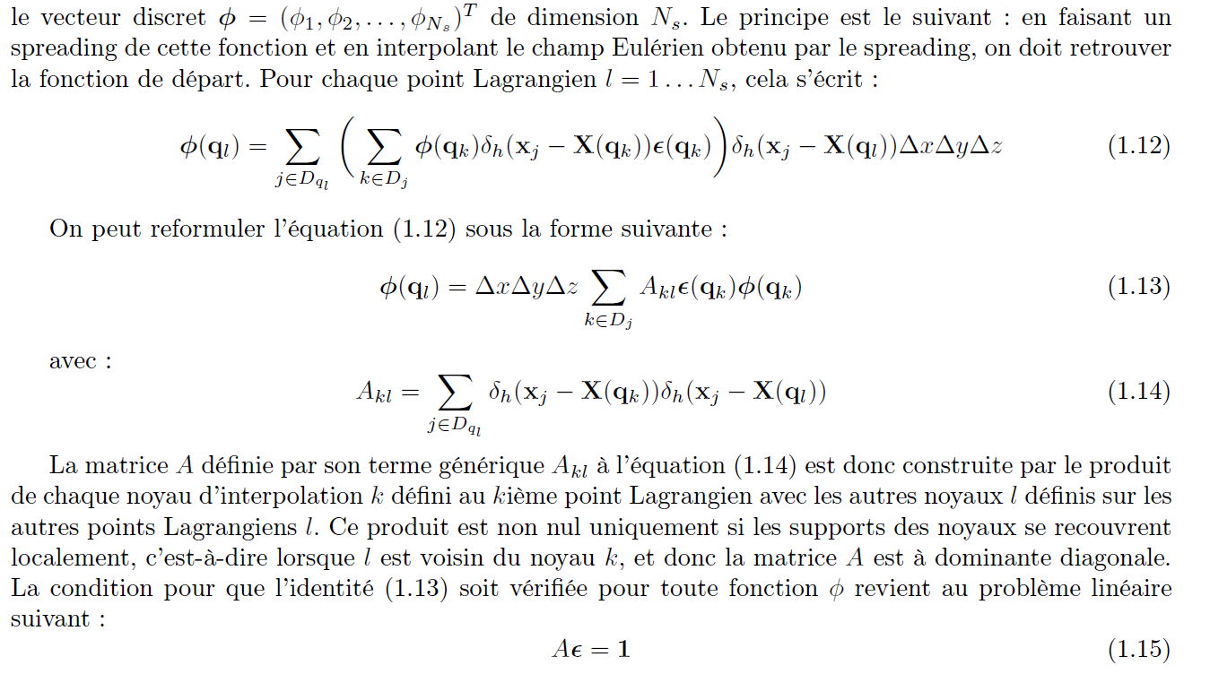
Reciprocity of the interpolating and spreading operators

Slide 29
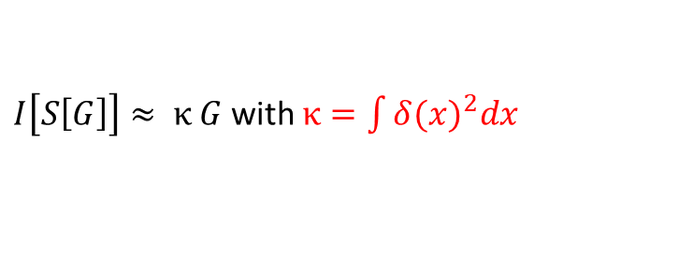
Linear system resolution
Exact solution : Matrix inversion
  Library used for the matrix inversion: LaPack (Linear Algebra Package)
  Matrix construction : 2 intertwined loops on the lagrangian points
  Computational time : High extra CPU cost
Iterative solution: BiConjugate gradient stabilized method, without preconditioner
  Directly implemented in ProLB
  Similar matrix construction
  Computational time : Middle extra CPU cost
Analytical Approached solution
  No linear system resolution
  Minor modification in ProLB
  Identical computational time : No extra CPU cost
$I\left[S\left[G\right]\right]≈ κ G$with $κ=\int{{δ(x)}^{2}dx}$

Slide 30
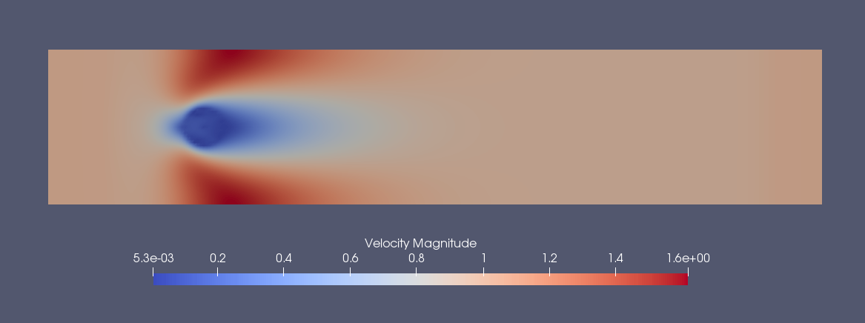
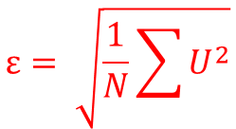
Calcul de l’erreur (RMSE) du flux de masse à la paroi du cylindre
méthode | Erreur ε | Temps de calcul
Kappa | 1e-4 | 1
Bicgstab | 5e-5 | 1.6
Inverse matrice | 1e-5 | 2.25
$$ε= \sqrt{\frac{1}{N}\sum{U^{2}}}$$

Slide 31
Conclusion
Development of a new coupling strategy to deal with moving boundaries in turbulent flows
The power wall law is used for turbulent near wall modeling
The immersed boundary method is coupled to the HRR LBM model and has proven to be accurate and robust on both academic and industrial test cases

Slide 32
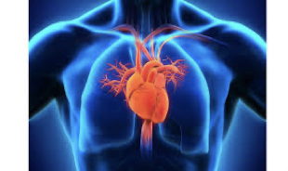
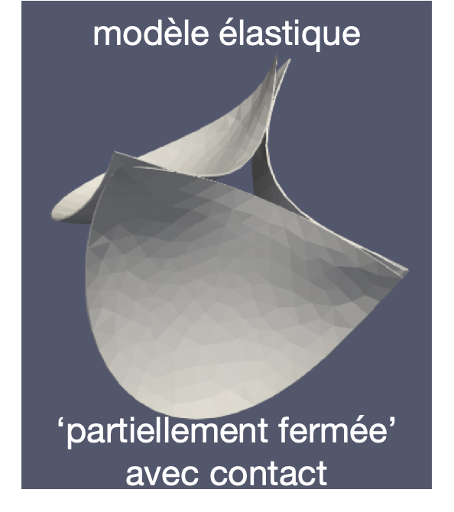
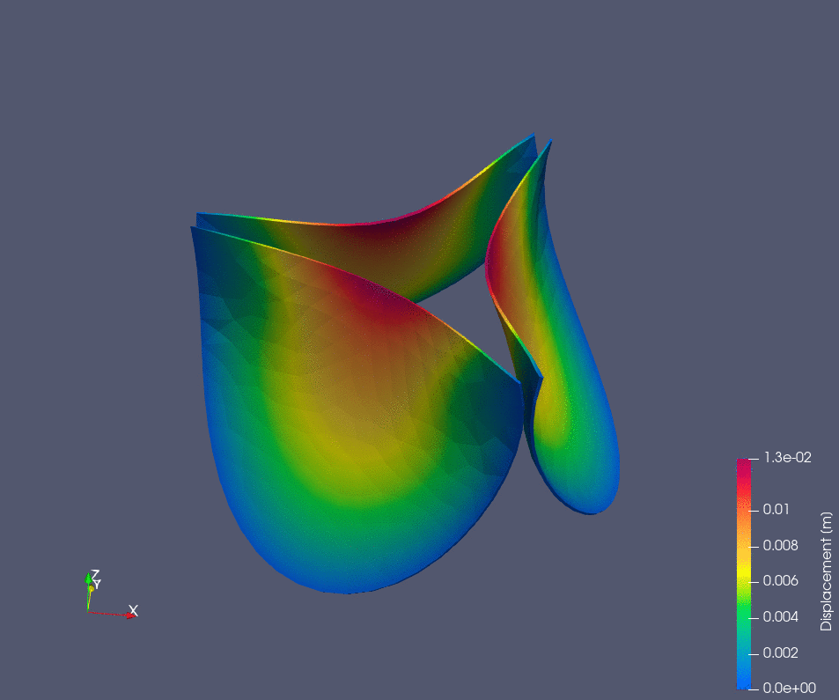
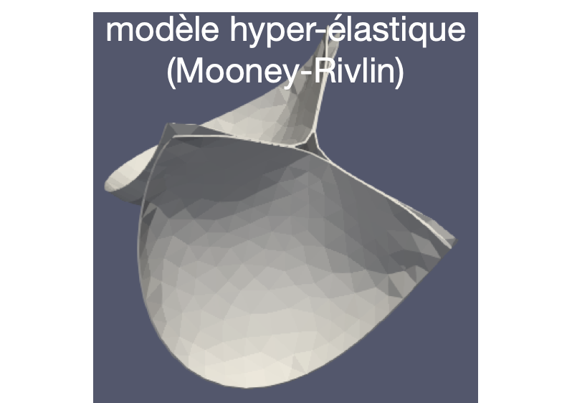
Fluid-structure interaction in ProLB
Work in progress
Résultats Hors-fluide (Calculix)
Ouverture/fermeture des sigmoïdes sur un cycle cardiaque (pression imposée)

